Slide 1
Query Processing and Optimization
Dr Ilayaraja N

Slide 2
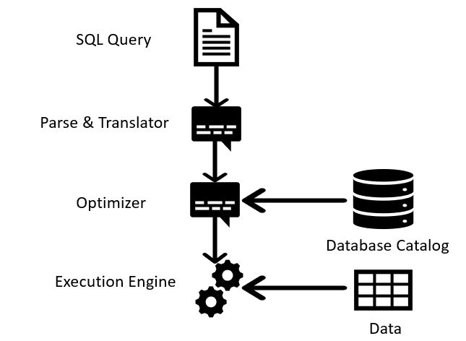
Introduction
DBMS techniques to process a query
  Scanner identifies query tokens
  Parser checks the query syntax
  Validation checks all attribute and relation names
  Query tree (or query graph) created
  Execution strategy or query plan devised
Query optimization
  Planning a good execution strategy

Slide 3
Introduction (cont’d.)
A query expressed in a high-level query language such as SQL must first be scanned,
parsed, and validated.
The scanner identifies the query tokens—such as SQL keywords, attribute names, and relation names—that appear in the text of the query,
the parser checks the query syntax to determine whether it is formulated according to the syntax rules (rules of grammar) of the query language.
The query must also be validated by checking that all attribute and relation names are valid
and semantically meaningful names in the schema of the particular database being queried.

Slide 4
Introduction (cont’d.)
An internal representation of the query is then created, usually as a tree data structure called a query tree.
It is also possible to represent the query using a graph data structure called a query graph, which is generally a directed acyclic graph (DAG).
The DBMS must then devise an execution strategy or query plan for retrieving the results of the query from the database files.
A query has many possible execution strategies, and the process of choosing a suitable one for processing a query is known as query optimization.
It focus on how queries are processed and what algorithms are used to perform individual operations within the query.

Slide 5
Basic Steps in Query Processing (cont.)
Parser and translator
  Parser checks syntax (e.g., correct relation and operator names)
  Translate the (SQL) query into relational algebra
  Translate the query into its internal form.
Query Optimizer
  The process of choosing a suitable execution strategy for processing a query.
  Chooses the most efficient implementation to execute the query
    Produces equivalent relational algebra expressions
    Annotates them with instructions (algorithms): query execution plan (QEP)
    Estimates the cost of each equivalent QEP, according to a given cost model
    Choose the “best” QEP
Evaluation engine
  The query-execution engine takes a query-evaluation plan, executes that plan, and returns the answers to the query

Slide 6
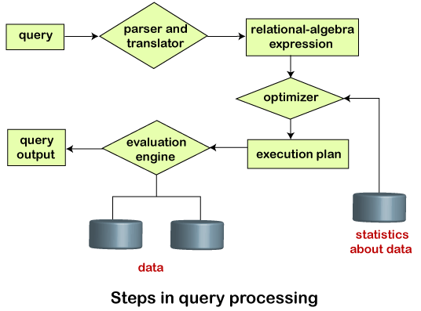
Basic Steps in Query Processing
1. Parsing and translation
2. Optimization
3. Query Evaluation Engine

Slide 7
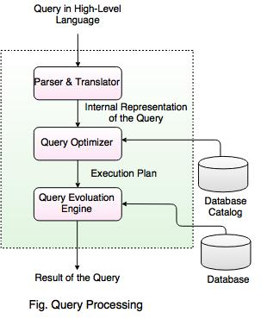
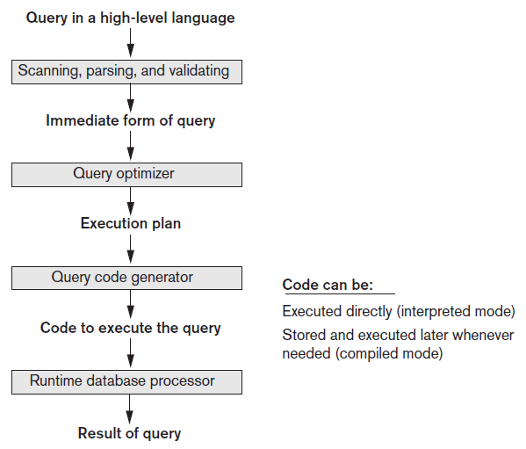
Query Processing

Slide 8
Basic Steps in Query Processing (cont.)
The query optimizer module has the task of producing a good execution plan, and the code generator generates the code to execute that plan.
The runtime database processor has the task of running (executing) the query code, whether in compiled or interpreted mode, to produce the query result.
If a runtime error results, an error message is generated by the runtime database processor.

Slide 9
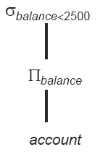
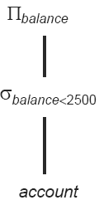
Basic Steps in Query Processing
Two internal representations of a query:
  Query Tree
  Query Graph
Select balance From account where balance < 2500
  σ_{balance<2500}(∏_{balance}(account))
  is equivalent to
  ∏_{balance}(σ_{balance<2500}(account))

Slide 10
Basic Steps in Query Processing
Annotated relational algebra expression
  Specifying detailed evaluation strategy is called an evaluation-plan.
  E.g., can use an index on balance to find accounts with balance < 2500,
  or can perform complete relation scan and discard accounts with balance ≥ 2500
Query Optimization:
  Amongst all equivalent evaluation plans choose the one with lowest cost.
  Cost is estimated using statistical information from the database catalog
    e.g. number of tuples in each relation, size of tuples

Slide 11
Basic Steps: Optimization
1st level of optimization: an SQL query has many equivalent relational algebra expressions
  σ_{salary<75000}(∏_{salary}(instructor)) and
  ∏_{salary}(σ_{salary<75000}(instructor)) are equivalent
  They both correspond to SELECT salary
  FROM instructor
  WHERE salary < 75000
2nd level of optimization: a relational algebra operation can be evaluated using one of several different algorithms
  e.g., block nested-loop join VS. merge-join; file scan VS. index scan
Input of optimization: a query in the form of an algebra expression
Output of optimization: the “best” annotated relational algebra expression specifying detailed evaluation strategy (query evaluation plan or query execution plan – QEP) answering the input query

Slide 12
Basic Steps: Optimization (Cont.)
Different query evaluation plans have different costs
  User is not expected to specify least-cost plans
Query Optimization: amongst all equivalent QEP choose the one with lowest cost
  Cost is estimated using statistical information from the database catalog
    # of tuples in relations, tuple sizes, # of distinct values for a given attribute, etc.
Evaluation of QEP)
  How to measure query costs (establish a cost model)
  Algorithms for evaluating relational algebra operations and their cost
  How to combine algorithms for individual operations in order to evaluate a complex expression (QEP)
Choosing the best QEP)
  How to optimize queries, that is, how to find a QEP with lowest estimated cost

Slide 13
Translating SQL Queries into Relational Algebra and Other Operators
SQL
  Query language used in most RDBMSs
Query decomposed into query blocks
  Basic units that can be translated into the algebraic operators
  Contains single SELECT-FROM-WHERE expression
    May contain GROUP BY and HAVING clauses

Slide 14
Translating SQL Queries into Relational Algebra (2)
SELECT LNAME, FNAME
FROM EMPLOYEE
WHERE SALARY > ( SELECT MAX (SALARY)
FROM EMPLOYEE
WHERE DNO = 5);
SELECT LNAME, FNAME
FROM EMPLOYEE
WHERE SALARY > C
SELECT MAX (SALARY)
FROM EMPLOYEE
WHERE DNO = 5
π_{LNAME, FNAME} (σ_{SALARY>C}(EMPLOYEE))
ℱ_{MAX SALARY} (σ_{DNO=5} (EMPLOYEE))

Slide 15
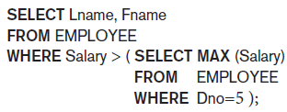


Translating SQL Queries (cont’d.)
Example:
  Inner block
  Outer block

Slide 16


Translating SQL Queries (cont’d.)
Example (cont’d.)
  Inner block translated into:
  Outer block translated into:
Query optimizer chooses execution plan for each query block

Slide 17
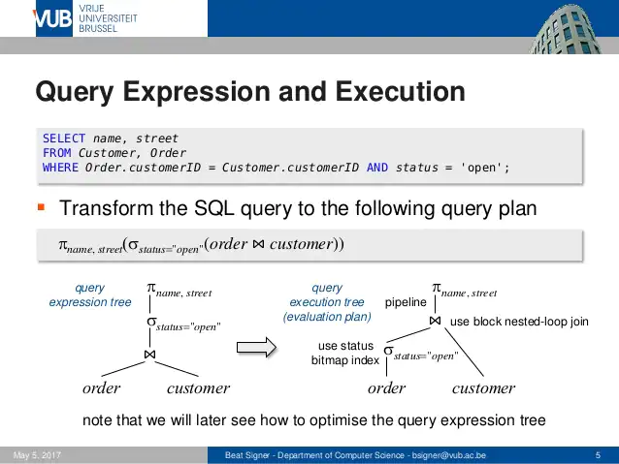

Slide 18
Measures of Query Cost
Response time (wall-clock time needed to execute a plan) depends on several factors
system configuration
  amount of dedicated buffer in RAM (aka, memory, main memory)
  whether or not indices are (partially) stored permanently in the buffer
runtime conditions
  amount of free buffer at the time the plan is executed
  content of the buffer at the time the plan is executed
  parameters, embedded in queries, which are resolved at runtime only
  SELECT salary
  FROM instructor
  WHERE salary < $a
  where $a is a variable provided by the application (user)
  Thus
  cost models (like ours) focus on resource consumption rather than response time
  (optimizers minimize resource consumption rather than response time)
  different optimizers may make different assumptions (parameters): every theoretical analysis must be recast with the actual parameters used by the concrete system (optimizer) to which the analysis is going to be applied

Slide 19
Measures of Query Cost (Cont.)
Query cost (total elapsed time for answering a query) is measured in terms of different resources
  disk access (I/O operation on disk)
  CPU usage
  (network communication for distributed DBMS – later in this course)
Typically disk access is the predominant cost, and is also relatively easy to estimate. Measured by taking into account
  Number of seeks (number of random I/O accesses)
  Number of blocks read
  Number of blocks written
    It is generally assumed cost for writing to be twice as the cost for reading
    (data is read back after being written to ensure the write was successful)
VERY IMPORTANT!!!
- “disk” refers to permanent drive for file storage, hard-disk, secondary memory, permanent memory
“memory” refers to volatile drive for data storage, RAM, main memory, buffer
These are all used as synonims
This is a so far accepted choice for measuring query costs (cost model).
New technologies: faster hard-disks (solid-state drives – SSD) and cheaper (thus bigger) RAM might direct towards different cost models (e.g., based also on CPU usage or RAM I/O operations)

